Slide 1

Data Mining in Online Social Networks: Modeling and Analyzing the Interplay of Social Relationships and Item Ratings
Martin Ester
Simon Fraser University
CASIN 2011, July 22, 2011

Slide 2
Introduction
The interplay of social relationships and item ratings
Generative model for social rating networks
[WWW 2011]
Recommendation in social networks: a matrix- factorization approach [RecSys 2010]
Outlook
Outline
Data Mining in Social Networks

Slide 3
Social networks have played an important role in the social sciences for a long time.
Nodes: actors/users, edges: social relationships/interactions (friendships, co-authorships, email exchanges, . . .)
Social scientists have observed phenomena such as social influence and selection and modeled them.
Introduction
Data Mining in Social Networks

Slide 4


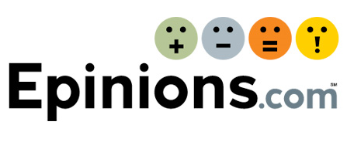
The emergence of online social networks
Allows us to test existing models and get understanding of large-scale social networks.
Online social networks can be exploited for tasks of immense commercial value:
- recommendation,
- viral marketing, etc.
Introduction
Data Mining in Social Networks

Slide 5
Social rating network (SRN):
social network, where users are associated with item ratings.
Item ratings can be numeric [1..5]
or Boolean (bookmark photo, like article, . . .).
Examples: Epinions, Flixster, last.fm,
flickr, Digg.
Two types of user actions: social actions, rating actions.
Introduction
Data Mining in Social Networks

Slide 6
Social influence:
ratings are influenced by ratings of friends,
i.e. friends are more likely to have similar ratings than strangers.
Correlational influence:
ratings are influenced by ratings of actors with similar ratings,
i.e. if some ratings are similar, further ratings are more likely also similar.
Interplay of social relationships and item ratings
Data Mining in Social Networks

Slide 7
Selection:
actors relate to actors with similar ratings,
i.e. actors with similar ratings are more likely to become friends.
Transitivity:
actors relate to friends of their friends,
i.e. actors are more likely to relate to indirect friends.
Interplay of social relationships and item ratings
Data Mining in Social Networks

Slide 8
Goals:
- insights into temporal dynamics of SRN,
- generations of synthetic networks,
- prediction of future behavior.
Approach
- probabilistic generative model
- at each discrete time stamp, generate one
(rating or social) action.
Generative model for social rating networks
Data Mining in Social Networks

Slide 9
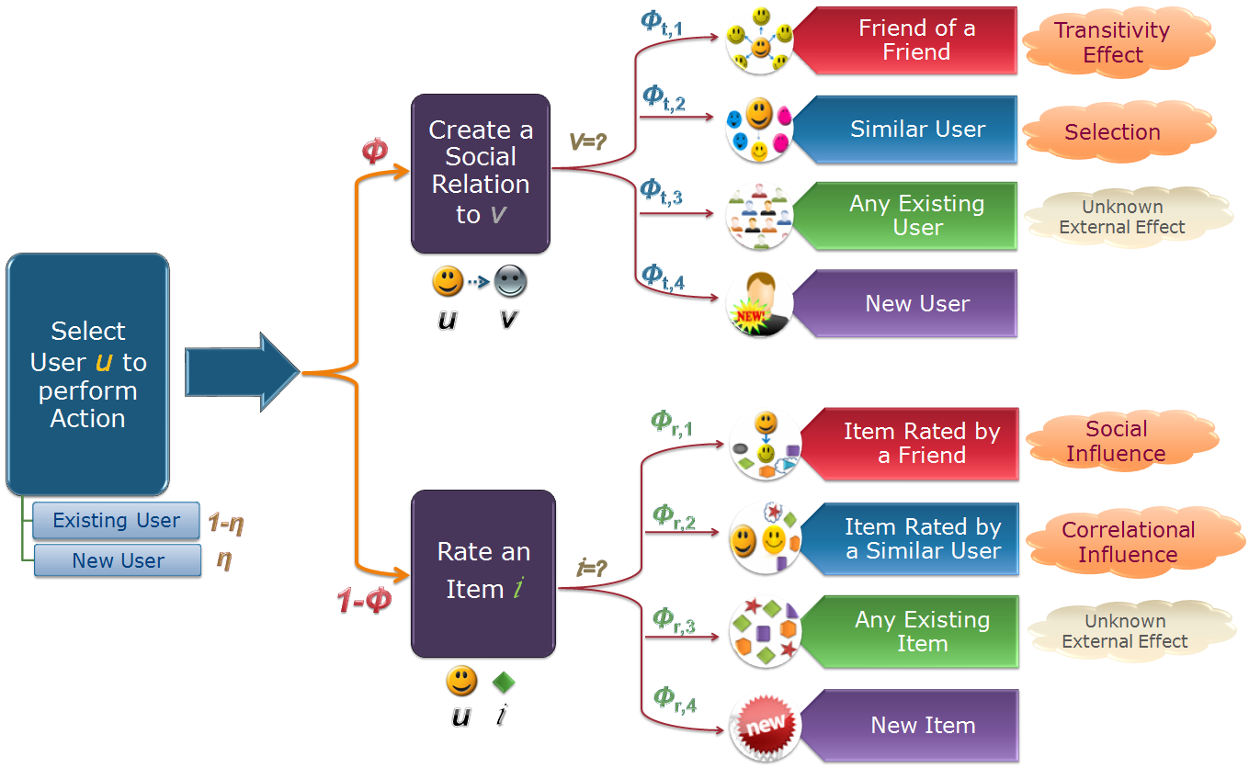
Generative model for social rating networks
Data Mining in Social Networks

Slide 10
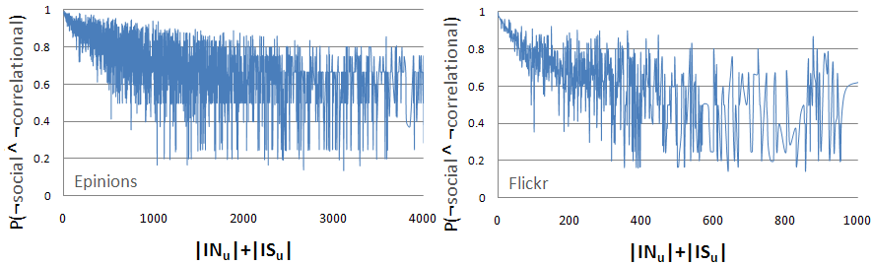
Impact of social and correlational influence on rating actions.
Social and correlational influence grow stronger with increasing numbers of users and links.
Generative model for social rating networks
Data Mining in Social Networks

Slide 11

Impact of selection and transitivity on social actions.
Selection and transitivity also grow stronger with the growth of SRN.
Generative model for social rating networks
Data Mining in Social Networks

Slide 12
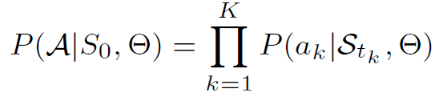
Likelihood of observed data
A: Set of actions
  A_{k}: action at timestamp k.
S_{t} : the state of SRN at time t
  set of rating and social actions performed so far
ϴ : the set of model parameters
Generative model for social rating networks
Data Mining in Social Networks

Slide 13
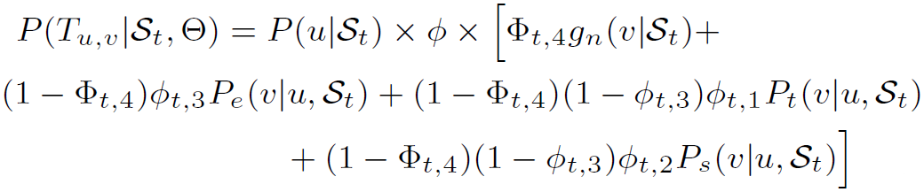
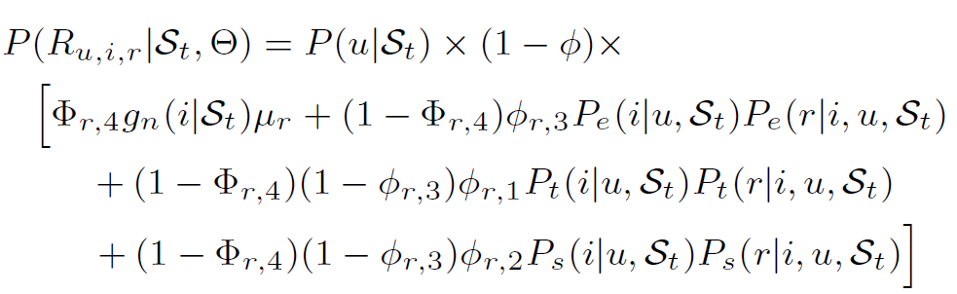
Likelihood of a social action
Likelihood of a rating action
Generative model for social rating networks
Data Mining in Social Networks

Slide 14
Maximum likelihood estimation using EM algorithm.
Datasets: Epinions, Flickr.
Comparison partners
- CrossModel, similar to [3]
  - SocialOnly, similar to [18]
  - SimilarOnly.
  [3] D. Crandall et al, Feedback effects between similarity and social influence in online communities. In KDD 2008.
  [18] E. Zheleva et al, Co-evolution of social and affiliation networks. In KDD 2009.
Generative model for social rating networks
Data Mining in Social Networks

Slide 15
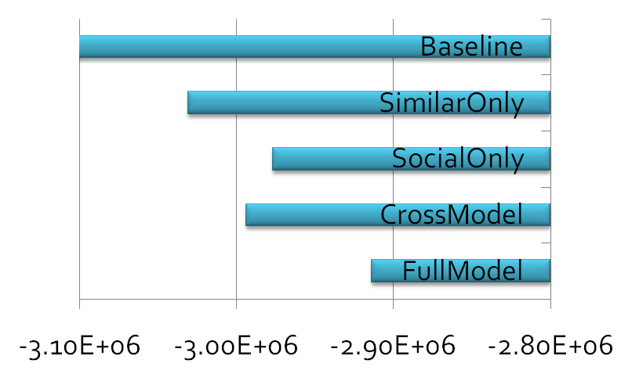
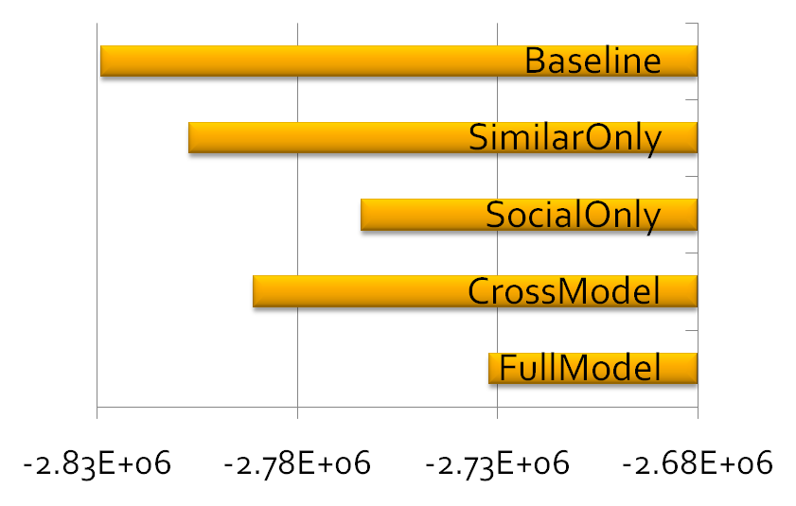
Comparing (log-) likelihood of comparison partners
Epinions Flickr
Generative model for social rating networks
Data Mining in Social Networks

Slide 16
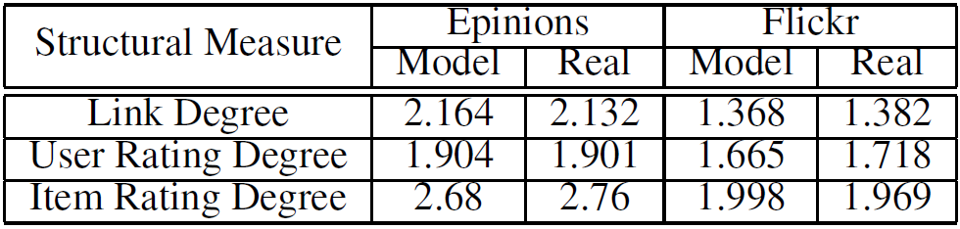
Comparing to real data
  Link Degree Distribution
  User rating degree distribution
  Item rating degree distribution
Generative model for social rating networks
Data Mining in Social Networks

Slide 17
Problem definition:
  Given user u and target item i
  Predict the rating r_{u,i}
Memory-based approach
- Lazy learner: CF, TrustWalker, . . .
Model-based approach
- Eager learner: Matrix factorization (MF)
often outperforms memory-based approach
Recommendation in social networks:
a matrix-factorization approach
Data Mining in Social Networks

Slide 18
Motivation for social network-based recommendation:
- social influence,
- can deal with cold-start users, as long as they
are connected to the social network.
Challenge
  Low probability of finding rater at small distance.
  Noisy ratings at large distances.
Recommendation in social networks:
a matrix-factorization approach
Data Mining in Social Networks

Slide 19
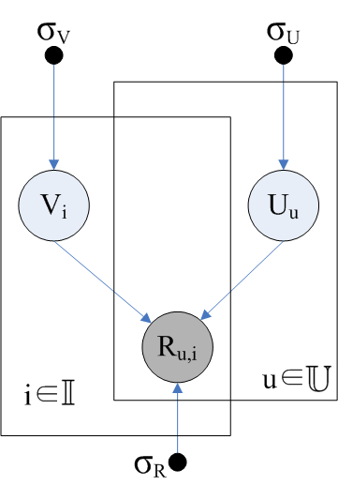


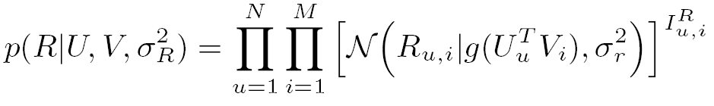
Observed ratings are governed by latent variables (features) of users and items.
Latent features for users
Latent features for items
Item ratings
g: logistic function, σ_{u}, σ_{V} , σ_{R} : normal priors
Recommendation in social networks:
a matrix-factorization approach
Data Mining in Social Networks

Slide 20
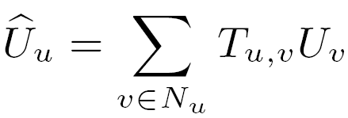
Social influence: behavior of a user u is affected by his direct neighbors N_{u}.
Latent features of a user depend on those of his neighbors.
T_{u,v} is the normalized trust value.
Trust propagation to indirect neighbors.
Recommendation in social networks:
a matrix-factorization approach
Data Mining in Social Networks

Slide 21
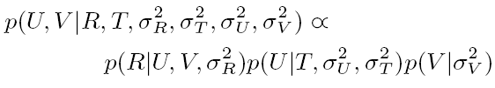
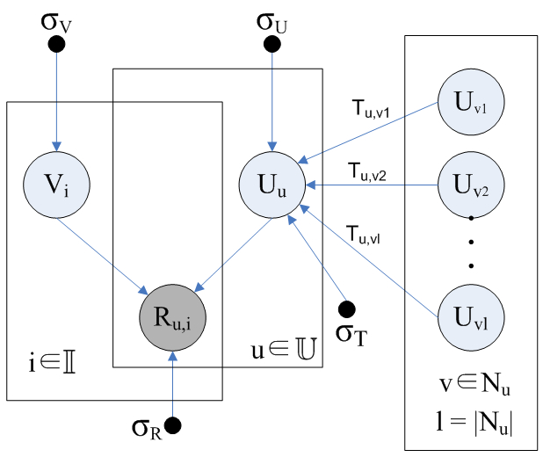
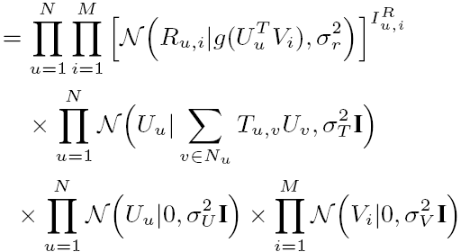
Recommendation in social networks:
a matrix-factorization approach
Data Mining in Social Networks

Slide 22
Recommendation in social networks:
a matrix-factorization approach
Data Mining in Social Networks

Slide 23
Recommendation in social networks:
a matrix-factorization approach
Data Mining in Social Networks

Slide 24
Recommendation in social networks:
a matrix-factorization approach
Data Mining in Social Networks

Slide 25








Parameter learning: gradient descent
We used
Recommendation in social networks:
a matrix-factorization approach
Data Mining in Social Networks

Slide 26
Comparison partners:
CF
Baseline MF
STE (Social Trust Ensemble)
SocialMF (our method)
Datasets:
Epinions
Flixster
Number k of features:
5 and 10
Recommendation in social networks:
a matrix-factorization approach
Data Mining in Social Networks

Slide 27
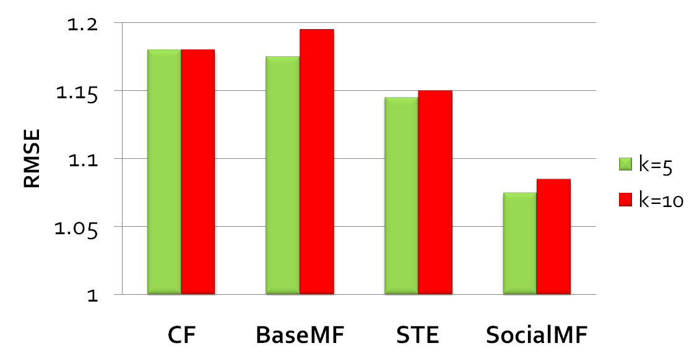
Epinions
Gain over STE: 6.2%. for K=5 and 5.7% for K=10
Recommendation in social networks:
a matrix-factorization approach
Data Mining in Social Networks

Slide 28
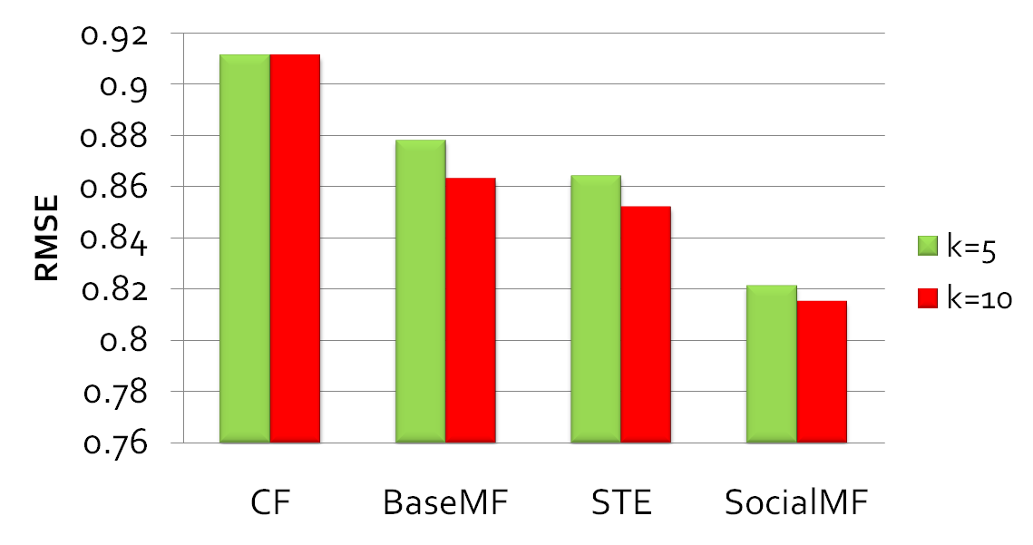
Flixster
SocialMF gain over STE (5%) is 3 times the STE gain over BasicMF (1.5%)
Recommendation in social networks:
a matrix-factorization approach
Data Mining in Social Networks

Slide 29
Top-N recommendation
Link recommendation
Community discovery [RecSys 2011]
- considering not only the topological structure
of social network, but also item ratings
- overlapping communities
Strength of social influence
inference of latent edge weights from observed
rating actions
Outlook
Data Mining in Social Networks

Slide 30
Mohsen Jamali, Martin Ester: A matrix factorization technique with trust propagation for recommendation in social networks.RecSys 2010.
Mohsen Jamali, Gholamreza Haffari, Martin Ester: Modeling the temporal dynamics of social rating networks using bidirectional effects of social relations and rating patterns. WWW 2011.
Mohsen Jamali, Tianle Huang, Martin Ester: A Generalized Stochastic Block Model for Recommendation in Social Rating Networks, RecSys 2011.
References
Data Mining in Social Networks

